Slide 1
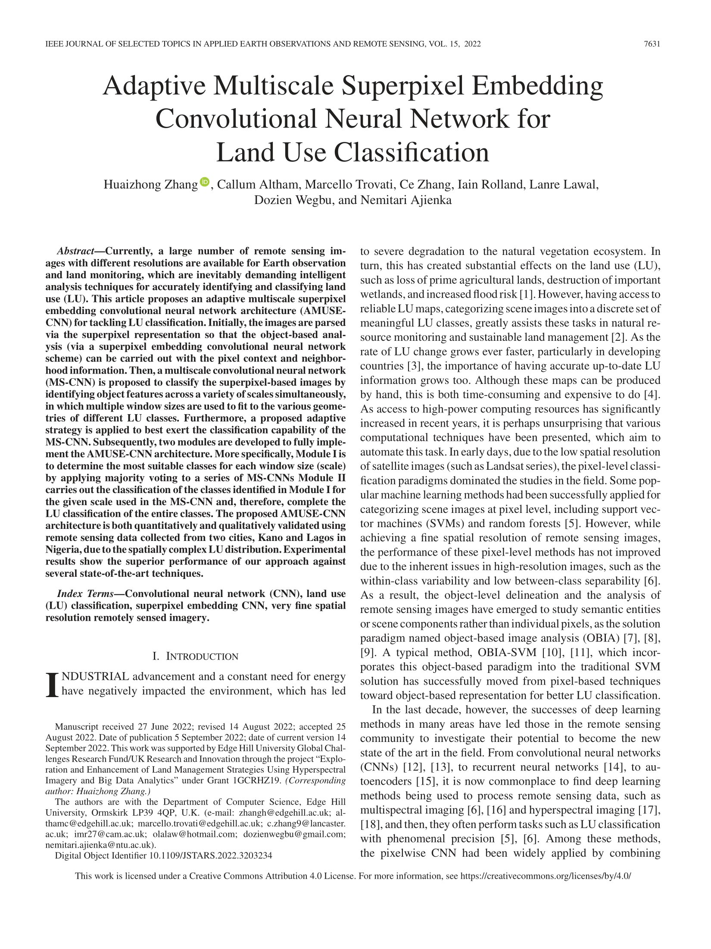
Land Use Classification
Huaizhong Zhang , Callum Altham, Marcello Trovati, Ce Zhang, Iain Rolland, Lanre Lawal,
Dozien Wegbu, and Nemitari Ajienka
A large number of remote sensing images are available for Earth observation and land monitoring.
These demand intelligent analysis techniques to accurately identify and classify Land Use.
This project created an adaptive multiscale architecture (AMUSE-CNN) for categorising different land areas by usage.
Experimental results show the superior performance of our approach against several state-of-the-art techniques.
Exploration and Enhancement of Land Management Strategies Using Hyperspectral Imagery and Big Data Analytics, UKRI GCRF/EHU, £ 20,270.71, Oct. 2020 – Sept. 2021.
Funding source: GCRF/EHU
Partners: Lancaster University (UK), University of Port Harcourt (Nigeria)

Slide 2
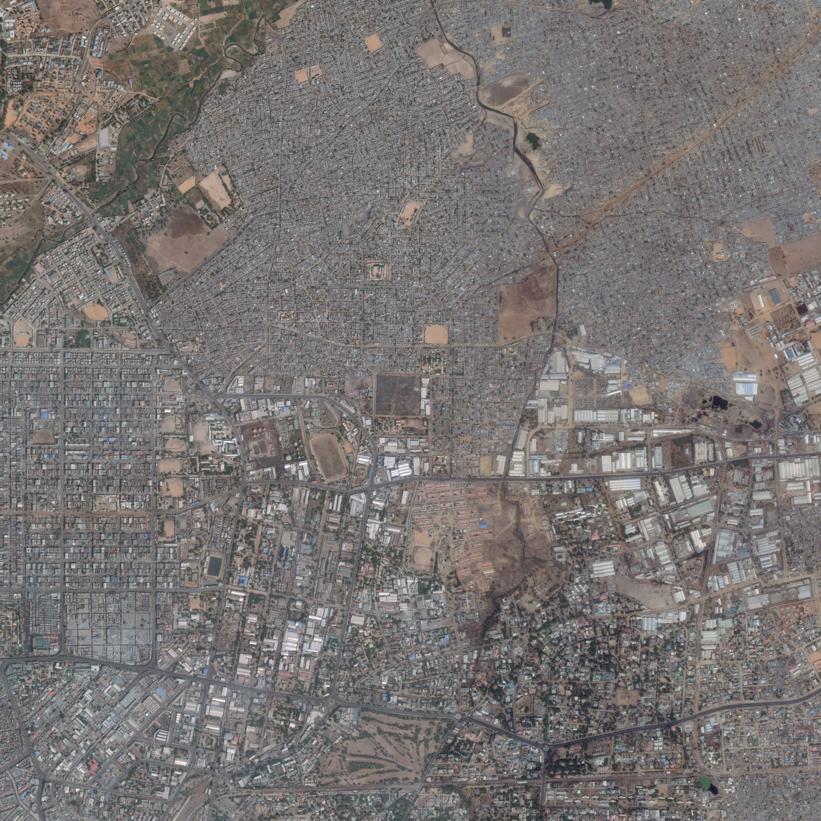
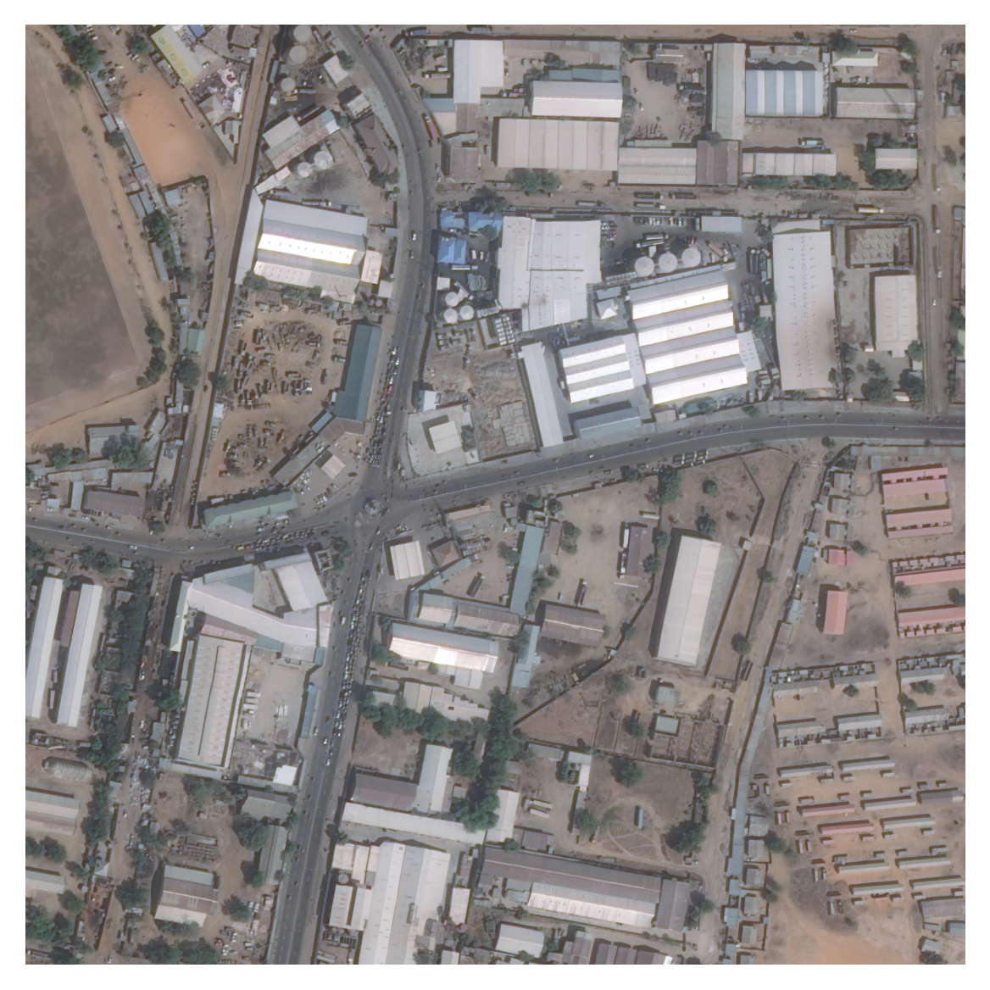
Exploration and Enhancement of Land Management Strategies Using Hyperspectral Imagery and Big Data Analytics, UKRI GCRF/EHU, £ 20,270.71, Oct. 2020 – Sept. 2021.
Funding source: GCRF/EHU
Partners: Lancaster University (UK), University of Port Harcourt (Nigeria)

Slide 3
Exploration and Enhancement of Land Management Strategies Using Hyperspectral Imagery and Big Data Analytics, UKRI GCRF/EHU, £ 20,270.71, Oct. 2020 – Sept. 2021.
Funding source: GCRF/EHU
Partners: Lancaster University (UK), University of Port Harcourt (Nigeria)

Slide 4
Exploration and Enhancement of Land Management Strategies Using Hyperspectral Imagery and Big Data Analytics, UKRI GCRF/EHU, £ 20,270.71, Oct. 2020 – Sept. 2021.
Funding source: GCRF/EHU
Partners: Lancaster University (UK), University of Port Harcourt (Nigeria)

Slide 5
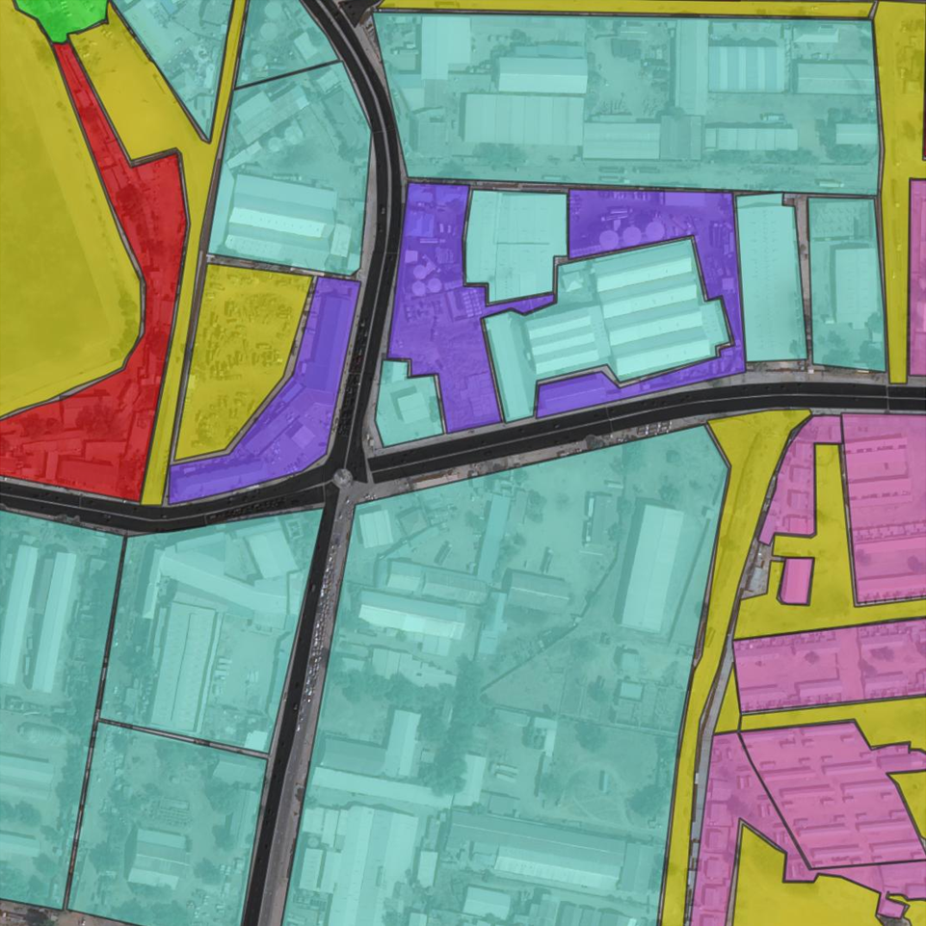
Land Use Classification
Exploration and Enhancement of Land Management Strategies Using Hyperspectral Imagery and Big Data Analytics, UKRI GCRF/EHU, £ 20,270.71, Oct. 2020 – Sept. 2021.
Funding source: GCRF/EHU
Partners: Lancaster University (UK), University of Port Harcourt (Nigeria)

Slide 6
Land Use Classification
Commercial
Exploration and Enhancement of Land Management Strategies Using Hyperspectral Imagery and Big Data Analytics, UKRI GCRF/EHU, £ 20,270.71, Oct. 2020 – Sept. 2021.
Funding source: GCRF/EHU
Partners: Lancaster University (UK), University of Port Harcourt (Nigeria)

Slide 7
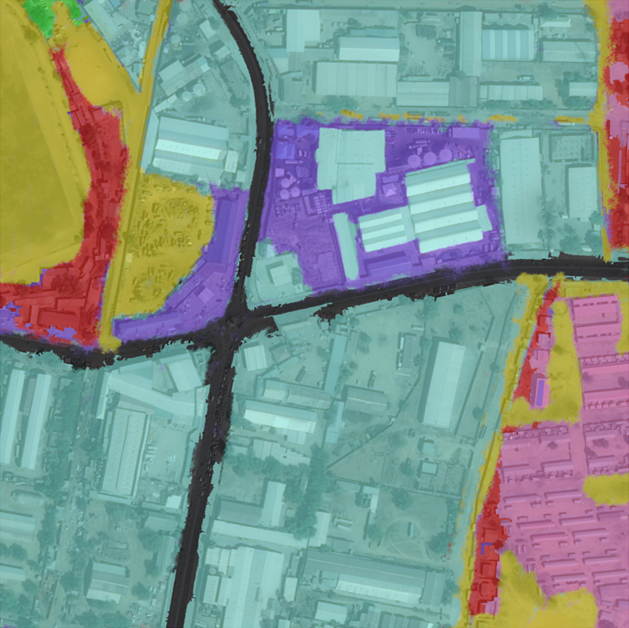
Land Use Classification
Commercial
Exploration and Enhancement of Land Management Strategies Using Hyperspectral Imagery and Big Data Analytics, UKRI GCRF/EHU, £ 20,270.71, Oct. 2020 – Sept. 2021.
Funding source: GCRF/EHU
Partners: Lancaster University (UK), University of Port Harcourt (Nigeria)

Slide 8
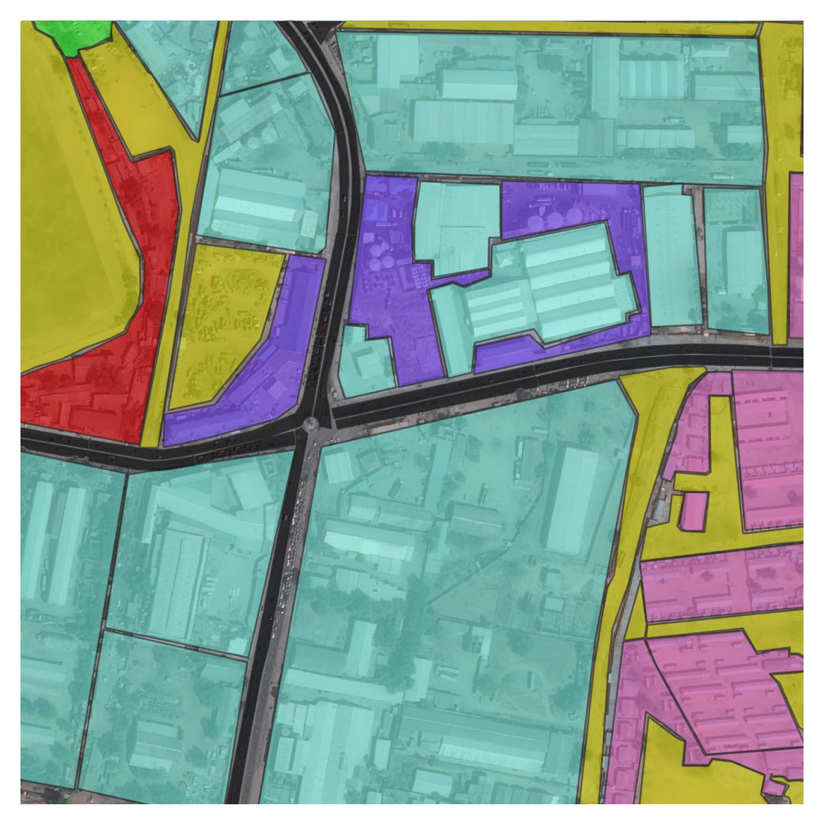

Land Use Classification
Commercial
Industrial
Exploration and Enhancement of Land Management Strategies Using Hyperspectral Imagery and Big Data Analytics, UKRI GCRF/EHU, £ 20,270.71, Oct. 2020 – Sept. 2021.
Funding source: GCRF/EHU
Partners: Lancaster University (UK), University of Port Harcourt (Nigeria)

Slide 9
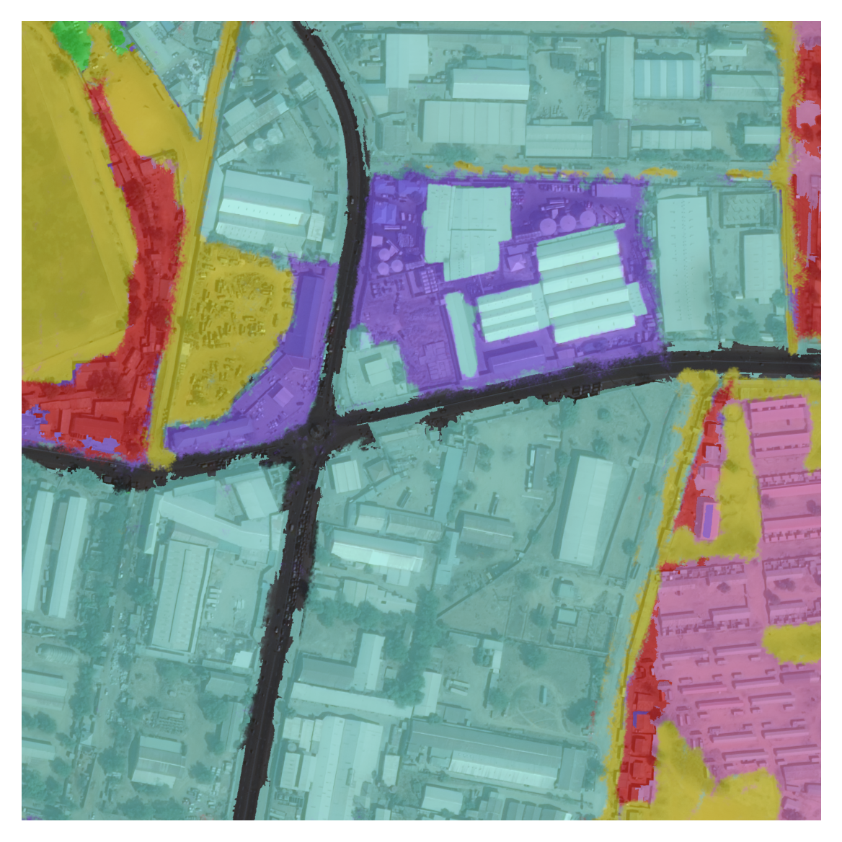

Land Use Classification
Commercial
Industrial
Exploration and Enhancement of Land Management Strategies Using Hyperspectral Imagery and Big Data Analytics, UKRI GCRF/EHU, £ 20,270.71, Oct. 2020 – Sept. 2021.
Funding source: GCRF/EHU
Partners: Lancaster University (UK), University of Port Harcourt (Nigeria)

Slide 10
Land Use Classification
Commercial
Industrial
Vegetation
Exploration and Enhancement of Land Management Strategies Using Hyperspectral Imagery and Big Data Analytics, UKRI GCRF/EHU, £ 20,270.71, Oct. 2020 – Sept. 2021.
Funding source: GCRF/EHU
Partners: Lancaster University (UK), University of Port Harcourt (Nigeria)

Slide 11
Land Use Classification
Commercial
Industrial
Vegetation
Exploration and Enhancement of Land Management Strategies Using Hyperspectral Imagery and Big Data Analytics, UKRI GCRF/EHU, £ 20,270.71, Oct. 2020 – Sept. 2021.
Funding source: GCRF/EHU
Partners: Lancaster University (UK), University of Port Harcourt (Nigeria)

Slide 12
Land Use Classification
Commercial
Industrial
Vegetation
Residential
Exploration and Enhancement of Land Management Strategies Using Hyperspectral Imagery and Big Data Analytics, UKRI GCRF/EHU, £ 20,270.71, Oct. 2020 – Sept. 2021.
Funding source: GCRF/EHU
Partners: Lancaster University (UK), University of Port Harcourt (Nigeria)

Slide 13
Land Use Classification
Commercial
Industrial
Vegetation
Residential
Exploration and Enhancement of Land Management Strategies Using Hyperspectral Imagery and Big Data Analytics, UKRI GCRF/EHU, £ 20,270.71, Oct. 2020 – Sept. 2021.
Funding source: GCRF/EHU
Partners: Lancaster University (UK), University of Port Harcourt (Nigeria)

Slide 14
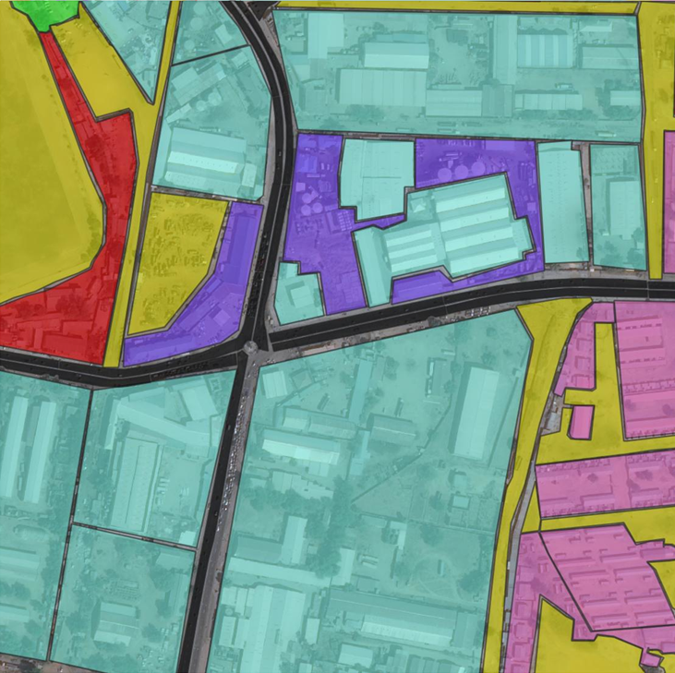
Land Use Classification
Commercial
Industrial
Vegetation
Residential
Road
Exploration and Enhancement of Land Management Strategies Using Hyperspectral Imagery and Big Data Analytics, UKRI GCRF/EHU, £ 20,270.71, Oct. 2020 – Sept. 2021.
Funding source: GCRF/EHU
Partners: Lancaster University (UK), University of Port Harcourt (Nigeria)

Slide 15
Land Use Classification
Commercial
Industrial
Vegetation
Residential
Road
Exploration and Enhancement of Land Management Strategies Using Hyperspectral Imagery and Big Data Analytics, UKRI GCRF/EHU, £ 20,270.71, Oct. 2020 – Sept. 2021.
Funding source: GCRF/EHU
Partners: Lancaster University (UK), University of Port Harcourt (Nigeria)

Slide 16
Land Use Classification
Commercial
Industrial
Vegetation
Residential
Road
Bare or Open Lands
Exploration and Enhancement of Land Management Strategies Using Hyperspectral Imagery and Big Data Analytics, UKRI GCRF/EHU, £ 20,270.71, Oct. 2020 – Sept. 2021.
Funding source: GCRF/EHU
Partners: Lancaster University (UK), University of Port Harcourt (Nigeria)

Slide 17
Land Use Classification
Commercial
Industrial
Vegetation
Residential
Road
Bare or Open Lands
Exploration and Enhancement of Land Management Strategies Using Hyperspectral Imagery and Big Data Analytics, UKRI GCRF/EHU, £ 20,270.71, Oct. 2020 – Sept. 2021.
Funding source: GCRF/EHU
Partners: Lancaster University (UK), University of Port Harcourt (Nigeria)

Slide 18
Land Use Classification
Commercial
Industrial
Vegetation
Residential
Road
Bare or Open Lands
Retail
Exploration and Enhancement of Land Management Strategies Using Hyperspectral Imagery and Big Data Analytics, UKRI GCRF/EHU, £ 20,270.71, Oct. 2020 – Sept. 2021.
Funding source: GCRF/EHU
Partners: Lancaster University (UK), University of Port Harcourt (Nigeria)

Slide 19
Land Use Classification
Commercial
Industrial
Vegetation
Residential
Road
Bare or Open Lands
Retail
Exploration and Enhancement of Land Management Strategies Using Hyperspectral Imagery and Big Data Analytics, UKRI GCRF/EHU, £ 20,270.71, Oct. 2020 – Sept. 2021.
Funding source: GCRF/EHU
Partners: Lancaster University (UK), University of Port Harcourt (Nigeria)

Slide 20
Land Use Classification
Original Image
Expected Predictions
Our Predictions
Exploration and Enhancement of Land Management Strategies Using Hyperspectral Imagery and Big Data Analytics, UKRI GCRF/EHU, £ 20,270.71, Oct. 2020 – Sept. 2021.
Funding source: GCRF/EHU
Partners: Lancaster University (UK), University of Port Harcourt (Nigeria)

